Slide 1
Towards Sustainable urban development
Present by Samuel Mabala, Commissioner for Urban Development

Slide 2
Sustainable Development
Development that meets the needs of the present without compromising the ability of future generations to meet their own needs’ (Brundtland commission)
The principle of sustainable urban development is based on equilibrium of resources, energy and financial input.
In general terms, sustainable urban development involves making development decisions and choices that respect the relationship between the three ‘Es- Economy, Ecology and Equity
Notes:
Economy: Economic activity should serve the common good, be self renewing and build local assets for sustainability
Ecology: Urban development is associated with various human activities such as industrial, human settlements, agriculture etc these impact differently on the natural habitat, they should therefore be controlled, guided and limited to ensure sustainability of the natural ecological assets within our cities for sustainable urban development.
Equity: Full participation of all stake holders in decision making is prerequisite for sustainable development, this can be achieved through good urban governance.

Slide 3
Situation Analysis
Urbanization is Organic and Not Planned
Urban Growth & Sprawl and Not Urban Development
Reactive and Not Pro-active Approaches
Sectoral Approach and Not Integrated
Physical Planning divorced from Socio-Economic Planning
Implementation is Piecemeal and Not Holistic
Management is characterized by weak capacities & political interferences
Abuse of Office
Notes:
Uganda has largely experienced organic urban growth as opposed to planned urban development. Urban growth refers to increase in population size and physical developments of an urban centre while urban development refers to

Slide 4
Situation Analysis
Plan Making as an end and Not Just one Component in the Management of the Urban Processes
Planning is Technical and Not Political Process
Planning is Decentralised and Not Centralised
Bottom-up as opposed to Top-down
Urbanization along infrastructure corridors
Funding of urban development is treated in the same way as rural development based on night population

Slide 5
Urban Sprawl
Poorly planned development threatens our environment, our health, and our quality of life in numerous ways.
Sprawl spreads development out over large area; puts long distances between homes, stores, and job centers; and makes people more & more dependent on driving in their daily lives.
Sprawl pollutes our air and water. As reliance on cars and pavement of more and more roads increases, so does smog and pollution from water runoff. It destroys more land for parks, farms and open space each year.

Slide 6
Urban Sprawl
Sprawl increases traffic on our neighborhood streets and highways. Sprawl lengthens trips and forces us to drive everywhere. More man-hours are wasted daily behind the wheel every year.
Sprawl wastes tax money. It pulls economic resources away from existing communities and spreads them out over sparse developments far away from the core. This leads to degradation of our older towns and cities and higher taxes.

Slide 7
Need for a new approach
Promote high density Mixed development

Slide 8
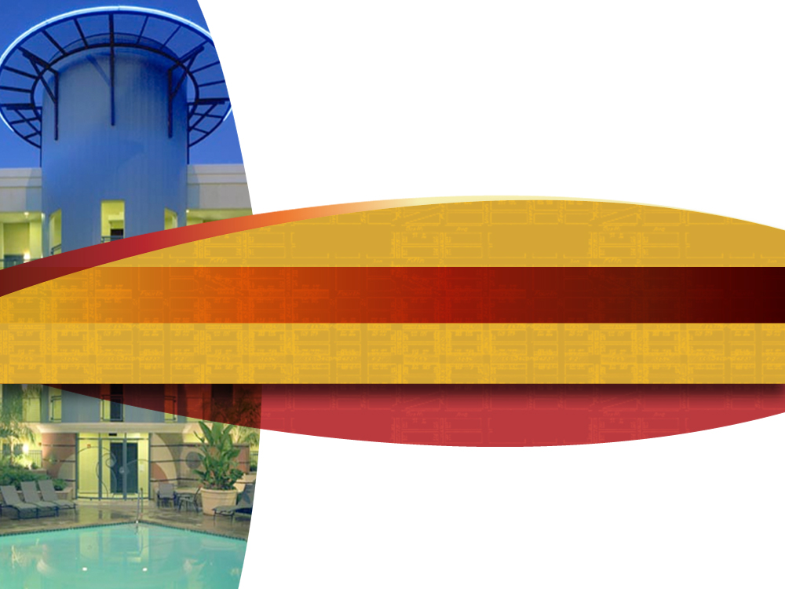
Imagine the Possibilities
Notes:
Here are some visual examples of how well-designed density can transform neighborhoods.
CLICK TO NEXT SLIDE

Slide 9
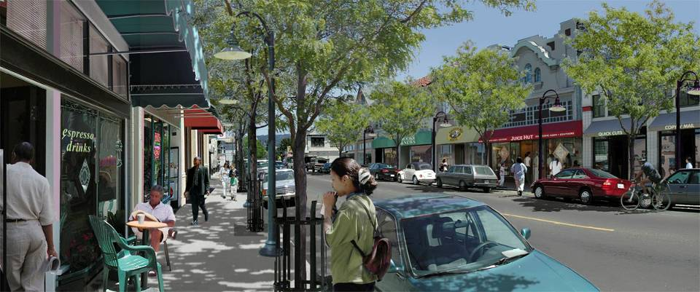
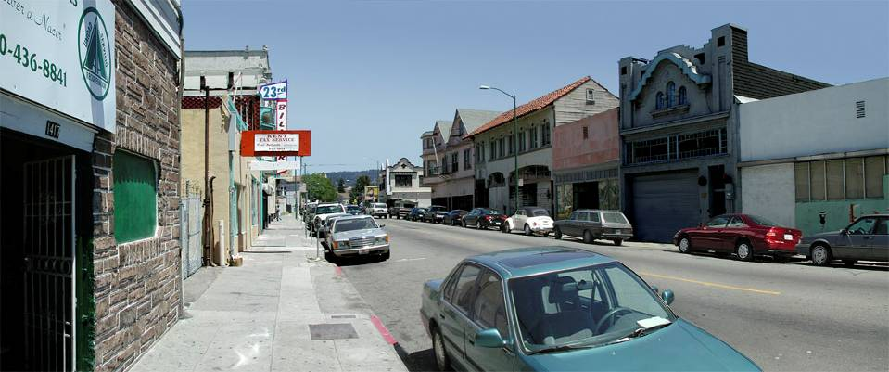
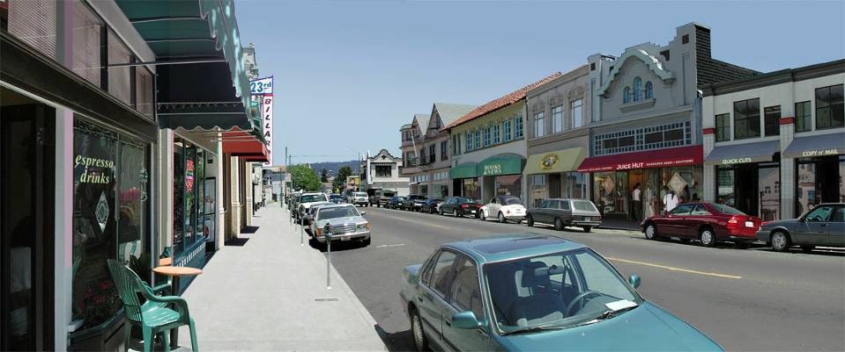
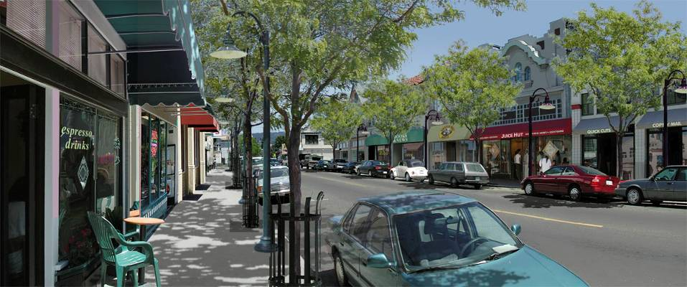
Neighborhood Commercial Center
Notes:
Just look at what we can create if we do this right.
CLICK TO START TRANSITION
We can create new commercial centers
CLICK TO NEXT SLIDE WHEN TRANSITION COMPLETE

Slide 10
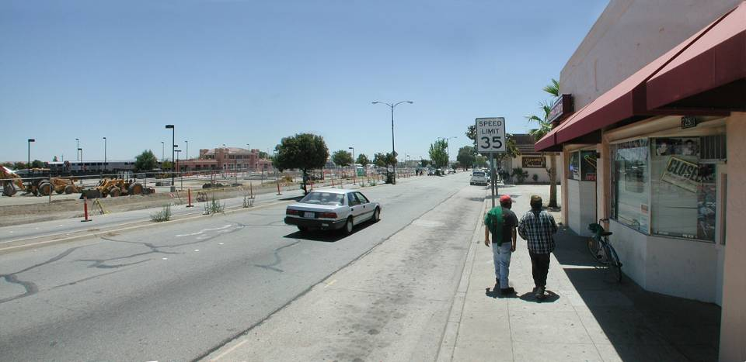
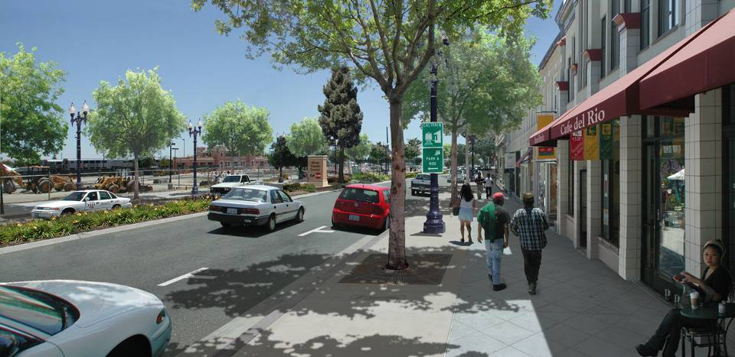
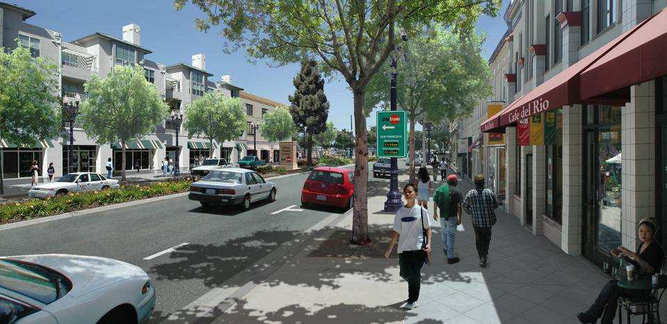
Redeveloping Transit-Oriented Areas
Notes:
We can create new transit-oriented areas.
CLICK TO BEGIN TRANSITION
CLICK TO NEXT SLIDE WHEN TRANSITION COMPLETE

Slide 11
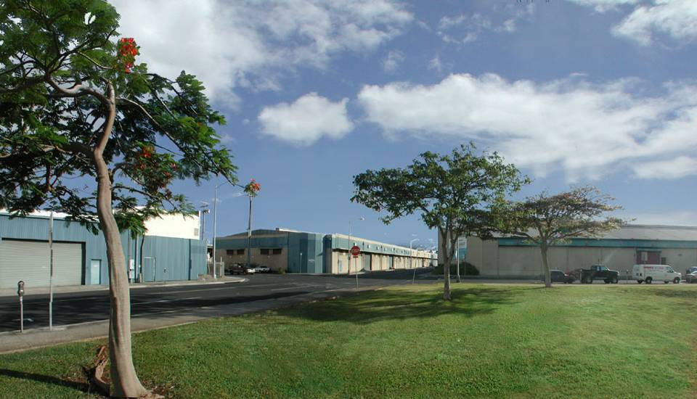
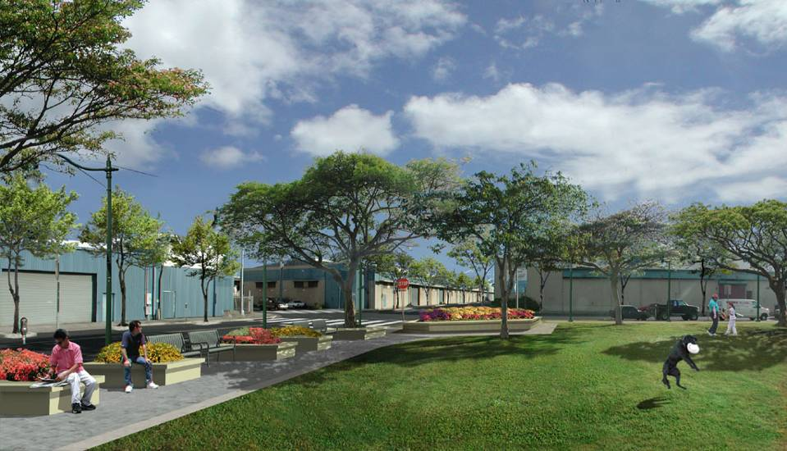
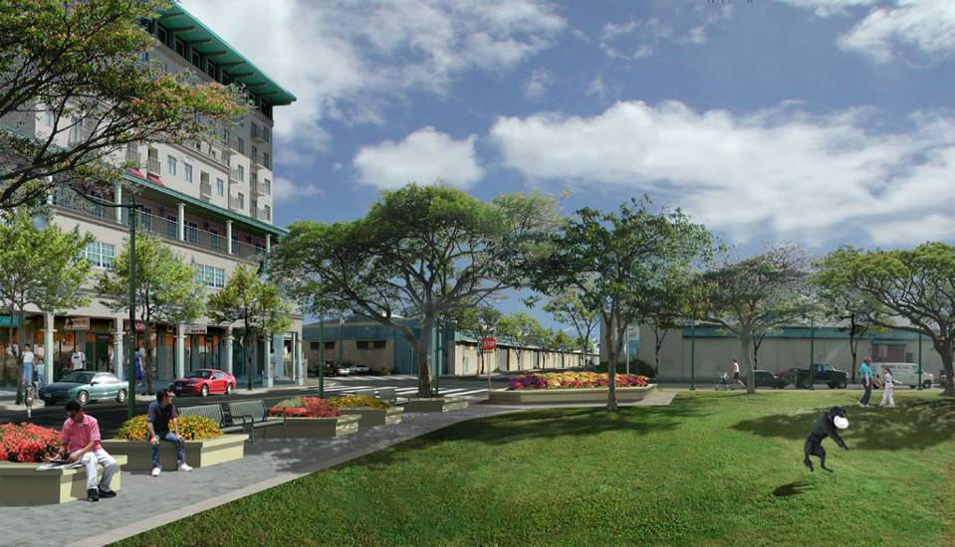
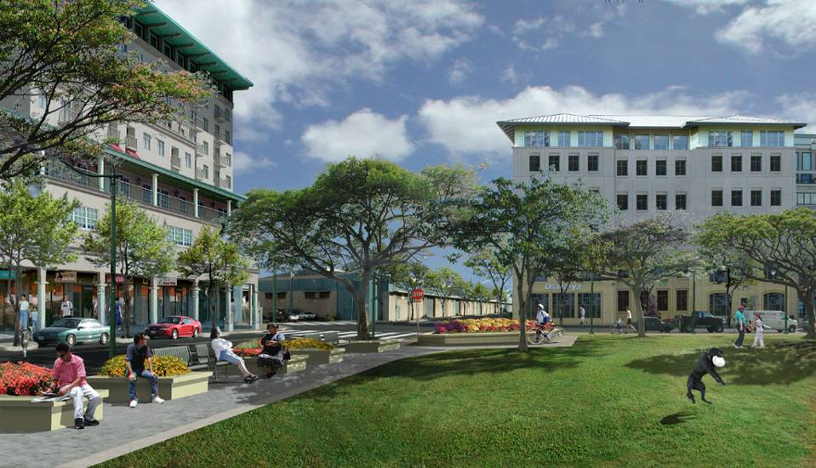
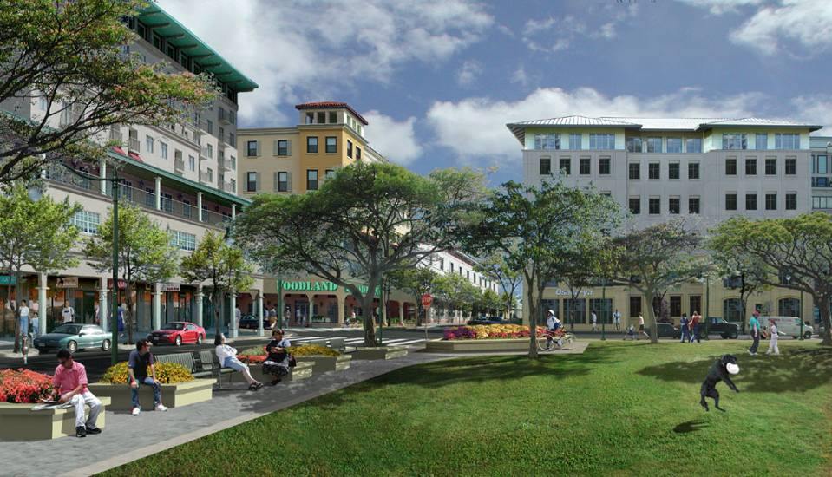
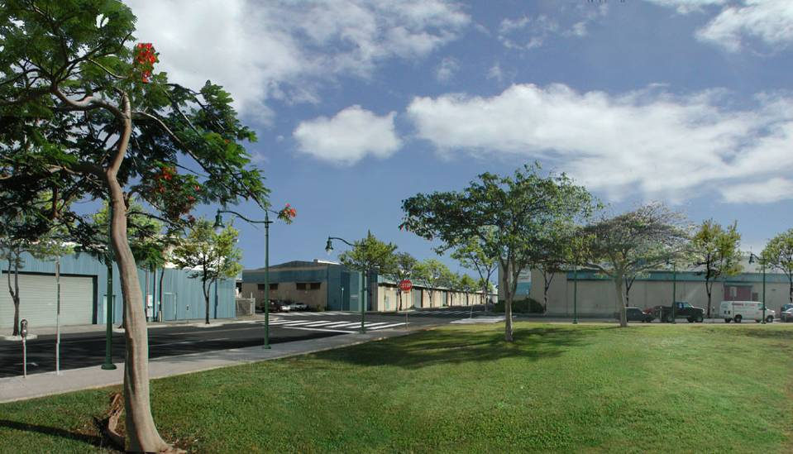
Redeveloping Industrial Sites
Notes:
And we can reclaim underused industrial areas.
CLICK TO BEGIN TRANSFORMATION
CLICK TO NEXT SLIDE

Slide 12
Urban Sector and Economic Development
Globally, the urban sector contributes more than two thirds of GDP of many countries.
It is a regular occurrence or established fact that as urbanization increases accompanied by industrialization, high economic growth is realized.
Generates employment for labour-force
Generate more revenue to Government Treasury in form of taxes, fees and property rates

Slide 13
Urban Sector & Econ. Devt
Provides large markets in which economies of scale can be exploited to enhance economic production
Optimizes the utilization of land which is a limited resource
Maximizes service utilization considering the large capital investment in services hence reduces per capita infrastructure expenditure
Engine of economic growth, incubator of democracy, innovation and centre of civilization and culture.

Slide 14
Implications of not Prioritizing Urban Devt.
Increased urban sprawl and Slumization of the urban areas
Increased urban poverty, unemployment and informal sector prevalence
Increased urban environmental degradation resulting into high vulnerability to disasters
Inability of the Urban Local authorities to generate adequate revenues

Slide 15
Implications (cont’d)
Increased urban crime & insecurity
Effect on optimal utilization of land that could undermine modernization of Agricultural
Uncompetitive urban economy to attract investment resources and capital, and above all
Reduced contribution of the sector to the GDP
Urban Chaos, indiscipline and a culture of impunity

Slide 16
The Desired Urban Future
Sustainable Livable Cities :-
Effective Urban Management & Efficient sustainable urbanization
Vibrant, Efficient, Productive & Competitive Urban Economy
Integrated & Efficient Urban Transportation System
Better urban services, infrastructure and utility
Attractive, Healthy, Resource Efficient Urban Environment with unique identity
Decent & affordable Housing for all.
Effective Urban Governance

Slide 17
How to Get there
The National Development Planning Framework
The Need for a National Urban Policy and relevant Legal and Regulatory Framework
The Need for an Integrated Participatory Planning Framework
The Need for Institutional capacity strengthening

Slide 18
How shall we know we have arrived?
Maintain Urban Development Indicators database to monitor performance of the urban sector.
Conduct a Urban Campaign as a vehicle for mobilization of support and resources for sustainable urban development

Slide 19
Expected Benefits
Increased Political Will
Stakeholder participation in urban policy review and legal reform process
Reform of Hierarchy of Settlements
Realization of Compact Cities
Adoption of Smart Growth Principles in Planning including Urban Consolidation and Urban Growth Limits

Slide 20
Expected Benefits (cont’d)
Partnerships and alliances formed among stakeholders
Pro-active Integrated urban planning realized
Slum and Informal settlements redeveloped
Urban social, economic and green infrastructure improved

Slide 21
Expected Benefits
Mixed development programmes promoted
Good urban governance realized.
Urban economy revitalized
Local capacities enhanced
Efficient & effective management of urban growth realized

Slide 22
Adopt Smart Growth
Enacting growth boundaries, parks and open space protections which allow growth without creating sprawl;
Planning pedestrian-friendly development where people have transportation choices, such as commuter trains and bus service;
Directing new highway transportation funds to existing communities to improve safety for walkers, bicyclists and drivers, and to promote public transportation choices;

Slide 23
Adopt Smart Growth (cont’d)
Reversing government programs and tax policies that help create sprawl. E.g. denying permits for the proposed highway that would destroy wetlands, increase air pollution and promote sprawl;
Saving taxpayers money by having developers pay impact fees to cover the costs of new roads, schools, water and sewer lines, and requiring property tax impact studies on new developments;
Advocating for revitalization of already developed areas through measures such as attracting new businesses, reducing crime and improving schools;

Slide 24
New Roads are not the answer
Increase funding for clean public transportation options such as fuel- efficient buses and light rail electric trains.
Reduce funding for road and car-only projects.
Increase funding for sidewalks and bike paths.
Encourage Transit-Oriented Development to integrate public transit with housing and business.

Slide 25
Transport Recommendations
Increase public involvement in the transportation planning process so citizens’ have an equal voice in their community’s future.
Encourage innovative incentive-based programs that encourage walking, biking, or car-pooling.
Authorize zoning decisions that encourage mixed use development.

Slide 26
Conclusion
Urbanization is a reality and all efforts must be made to guide this transformation process. Although the urbanization level is still relatively low at 18% in Uganda, the high growth rate of 5.2% poses an enormous threat. This is therefore the right time for collective action to shape the Uganda urban future.
This calls for a paradigm shift from the present reactive form of management to proactive, integrated and participatory planning approaches that will ensure optimum utilization of resources for sustainable urban development.
The need for a National Urban Forum is therefore justified to realize a desired urban future

Slide 27
I Thank You for your Kind Attention. God Bless Uganda! Contact: samuel.mabala@gmail.com

